Slide 1
Clean code
SoftUni Team
Technical Trainers
Software University
https://softuni.bg

Slide 2
Table of Contents
What is Clean Code?
Code Standards
Code Principles
Documentation and Comments
Modularity and classes
Testing
2

Slide 3
Have a Question?
sli.do
#Flask

Slide 4
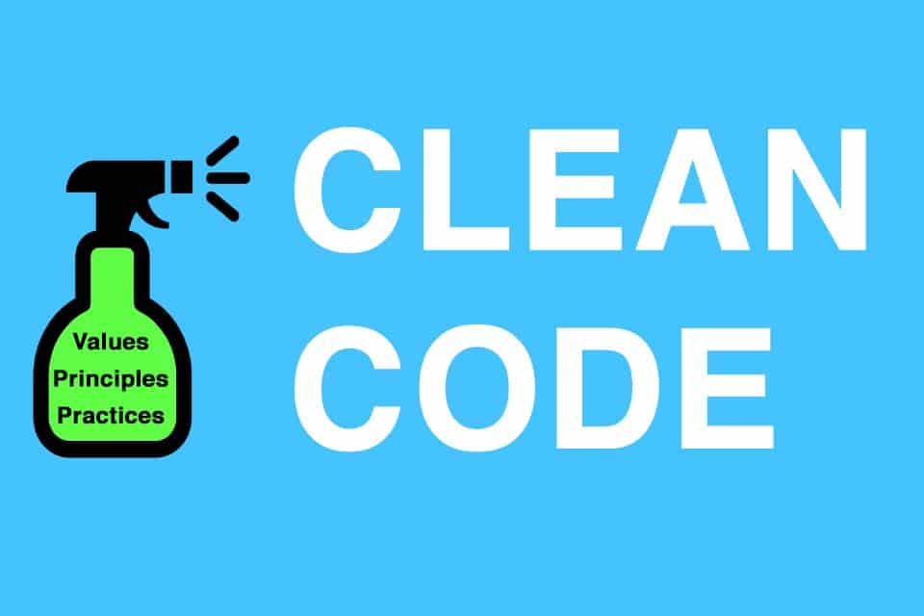
What is it

Slide 5
Definition
Clean code is a set of rules and principles that helps to keep our code readable, maintainable, and extendable.
It's one of the most important aspects of writing quality software.
We (developers) spend way more time reading the code than actually writing it, which is why it's important that we write good code.
Writing code is easy, but writing good, clean code is hard.

Slide 6
Why?
Writing clean code has a number of benefits. For instance, clean code is:
easy to understand
more efficient
easier to maintain, scale, debug, and refactor
tends to require less documentation.

Slide 7

Standarts

Slide 8
Standarts
Code standards are collections of coding rules, guidelines, and best practices. Each programming language comes with its own coding standards, which should be followed in order to write cleaner code. They usually address:
file organization
programming-practices and principles
code formatting (indentation, declarations, statements)
naming conventions
comments

Slide 9
PEP 8 (Python Enhancement Proposal)
class names should be CamelCase (MyClass)
variable names should be snake_case and all lowercase (first_name)
function names should be snake_case and all lowercase (quick_sort())
constants should be snake_case and all uppercase (PI = 3.14159)
modules should have short, snake_case names and all lowercase (numpy)
single quotes and double quotes are treated the same (just pick one and be consistent)

Slide 10
PEP 8 (Python Enhancement Proposal)
indent using 4 spaces (spaces are preferred over tabs)
lines should not be longer than 79 characters
avoid multiple statements on the same line
top-level function and class definitions are surrounded with two blank lines
method definitions inside a class are surrounded by a single blank line
imports should be on separate lines

Slide 11
PEP 8 (Python Enhancement Proposal)
avoid extra spaces within brackets or braces
avoid trailing whitespace anywhere
always surround binary operators with a single space on either side
if operators with different priorities are used, consider adding whitespace around the operators with the lowest priority
don't use spaces around the = sign when used to indicate a keyword argument

Slide 12
PEP 8 (Python Enhancement Proposal)
comments should not contradict the code
comments should be complete sentences
comments should have a space after the # sign with the first word capitalized
multi-line comments used in functions (docstrings) should have a short single-line description followed by more text

Slide 13
Code formatters
The most popular Python code formatters are:
black
flake8
autopep8
yapf

Slide 14
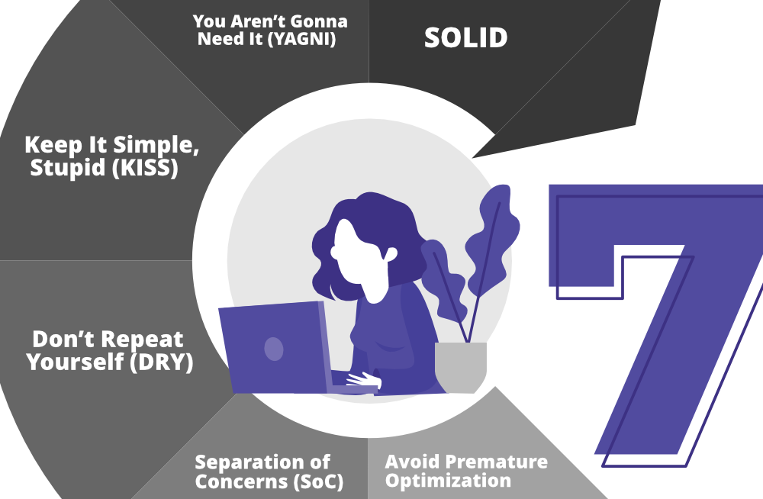
Code principles

Slide 15
Principles
DRY (Don't repeat yourself) - code should not be duplicated. Instead of duplicating lines, find an algorithm that uses iteration
KISS (Keep it simple, stupid) - most systems work best if they are kept simple rather than made complicated. Simplicity should be a key goal in design, and unnecessary complexity should be avoided.
SoC (Separation of concerns) - a good example of SoC is MVC (Model - View - Controller).

Slide 16
Principles 2
SOLID - extremely useful when writing OOP code. It talks about splitting your class into multiple subclasses, inheritance, abstraction, interfaces, and more.
The Single-responsibility principle: "A class should have one, and only one, reason to change."
The Open–closed principle: "Entities should be open for extension, but closed for modification."
The Liskov substitution principle: "Functions that use pointers or references to base classes must be able to use objects of derived classes without knowing it."

Slide 17
Principles 3
The Interface segregation principle: "A client should not be forced to implement an interface that it doesn’t use."
The Dependency inversion principle: "Depend upon abstractions, not concretions."

Slide 18

Comments

Slide 19
Comments
No matter how hard we try to write clean code, there are still going to be parts of your program that need additional explanation.
Comments allow us to quickly tell other developers (and our future selves) why we wrote it in the manner that we did.
Keep in mind that adding too many comments can make your code messier than it would be without them.

Slide 20
Comments
One line
Function/class docs
# This checks if the user with the given ID doesn't exist.
def create_approver(data):
"""
Hashes the plain password
:param complainer_data: dict
:return: complainer
"""
data["password"] = generate_password_hash(data['password'], method='sha256')
approver = ApproverModel(**data)
return AuthManager.encode_token(approver)

Slide 21

Modularity and Classes

Slide 22
Modularity
In order to keep your code as organized as possible, you should split it into multiple files which are then split up into different directories.
If you're writing code in an OOP-oriented language you should also follow basic OOP principles like encapsulation, abstraction, inheritance, and polymorphism.
Splitting code into multiple classes will make your code easier to understand and maintain.

Slide 23
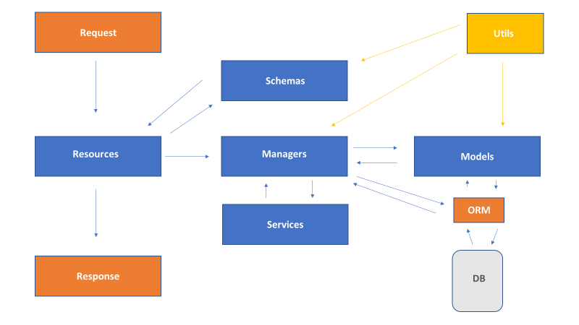
Flask example
│ .env
│ config.py
│ main.py
│ requirements.txt
│ __init__.py
│
├───managers
│
├───migrations
│
├───models
│
├───resources
│
├───schemas
│
├───utils

Slide 24

Testing

Slide 25
Testing
Quality software doesn't come without tests.
Testing software allows us to discover bugs and errors in the software before it is deployed.
Tests are of the same importance as production code

Slide 26

Live Demo

Slide 27
Questions?
Notes:
27

Slide 28












SoftUni Diamond Partners

Slide 29


Educational Partners

Slide 30
Trainings @ Software University (SoftUni)
Software University – High-Quality Education, Profession and Job for Software Developers
softuni.bg, softuni.org
Software University Foundation
softuni.foundation
Software University @ Facebook
facebook.com/SoftwareUniversity
Software University Forums
forum.softuni.bg
30
Notes:
30

Slide 31

License
This course (slides, examples, demos, exercises, homework, documents, videos and other assets) is copyrighted content
Unauthorized copy, reproduction or use is illegal
© SoftUni – https://softuni.org
© Software University – https://softuni.bg
Notes:
31

